Slide 1
Steganographic Message Encryption & Decryption Using Images
Image Steganography
Presented By
Student Name : N.Hitesh
College Name & Department :Narayana engineering college &
Computer Science Engineering

Slide 2
OUTLINE
Problem Statement
Technology used
Wow factor
End users
Result
Conclusion
Git-hub Link
Future scope

Slide 3
Problem Statement
Traditional encryption methods are vulnerable to hacking.
Sensitive messages sent via text or email can be intercepted.
Encryption leaves traces, making messages a target.
Image steganography hides data invisibly, enhancing security.

Slide 4
Technology used
Programming Language: Python
Libraries: OpenCV, NumPy
Image Processing: Pixel manipulation for data embedding
Encryption Method: ASCII-based encoding with passcode protection
Image Format: PNG (ensures lossless data storage)

Slide 5
Wow factors
Message is hidden within image pixels without detection.
No extra files—image itself stores the secret message.
Decryption is only possible with the correct passcode.
Image quality remains unchanged after encryption.
Enhances security by avoiding obvious encryption traces.

Slide 6
End users
Cybersecurity & Data Protection Experts
Journalists & Whistleblowers
Private Communication Users
Military & Intelligence Agencies

Slide 7

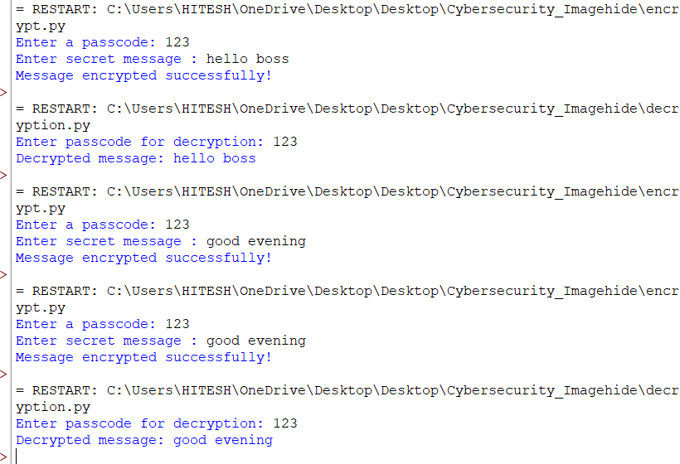

Results
Prevents unauthorized access using passcode-based decryption.
Maintains image quality without noticeable changes.

Slide 8
Conclusion
Image steganography securely hides messages within images.
Passcode protection prevents unauthorized access.
Maintains image quality while ensuring data security.
Useful for confidential communication and data protection.
Can be enhanced with stronger encryption methods.

Slide 9
GitHub Link
https://github.com/Hitesh217n/IBM-cybersecurity-.git

Slide 10
Future scope
Develop AI-based methods to detect hidden messages.
Expand steganography to videos for larger data storage.
Enhance security with AES or quantum encryption.
Optimize encoding to reduce file size impact.
Integrate with secure messaging applications.

Slide 11
THANK YOU

